Slide 1


Automatic Remastering Of Classic Video Games
Zijie Zhu (zz2973)

Slide 2
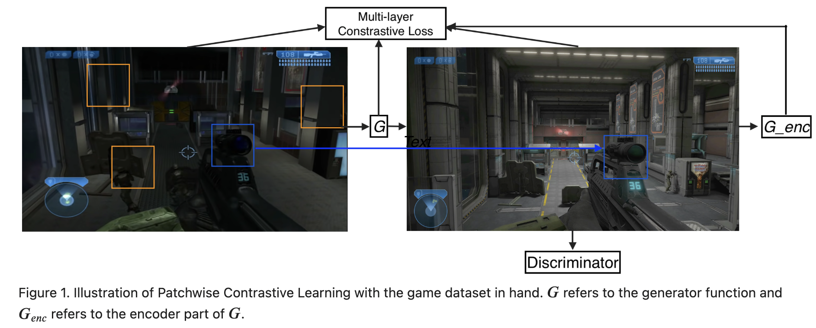
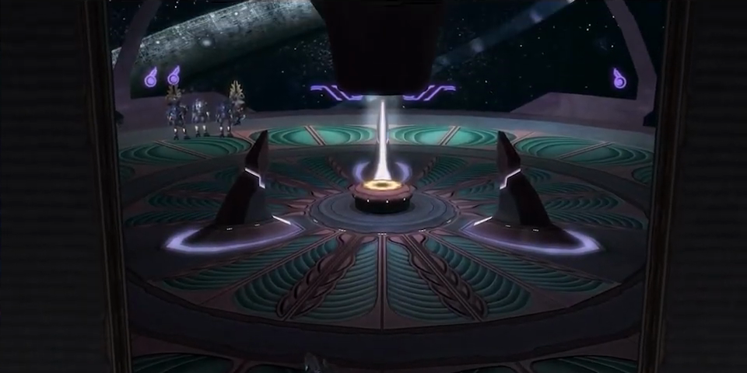
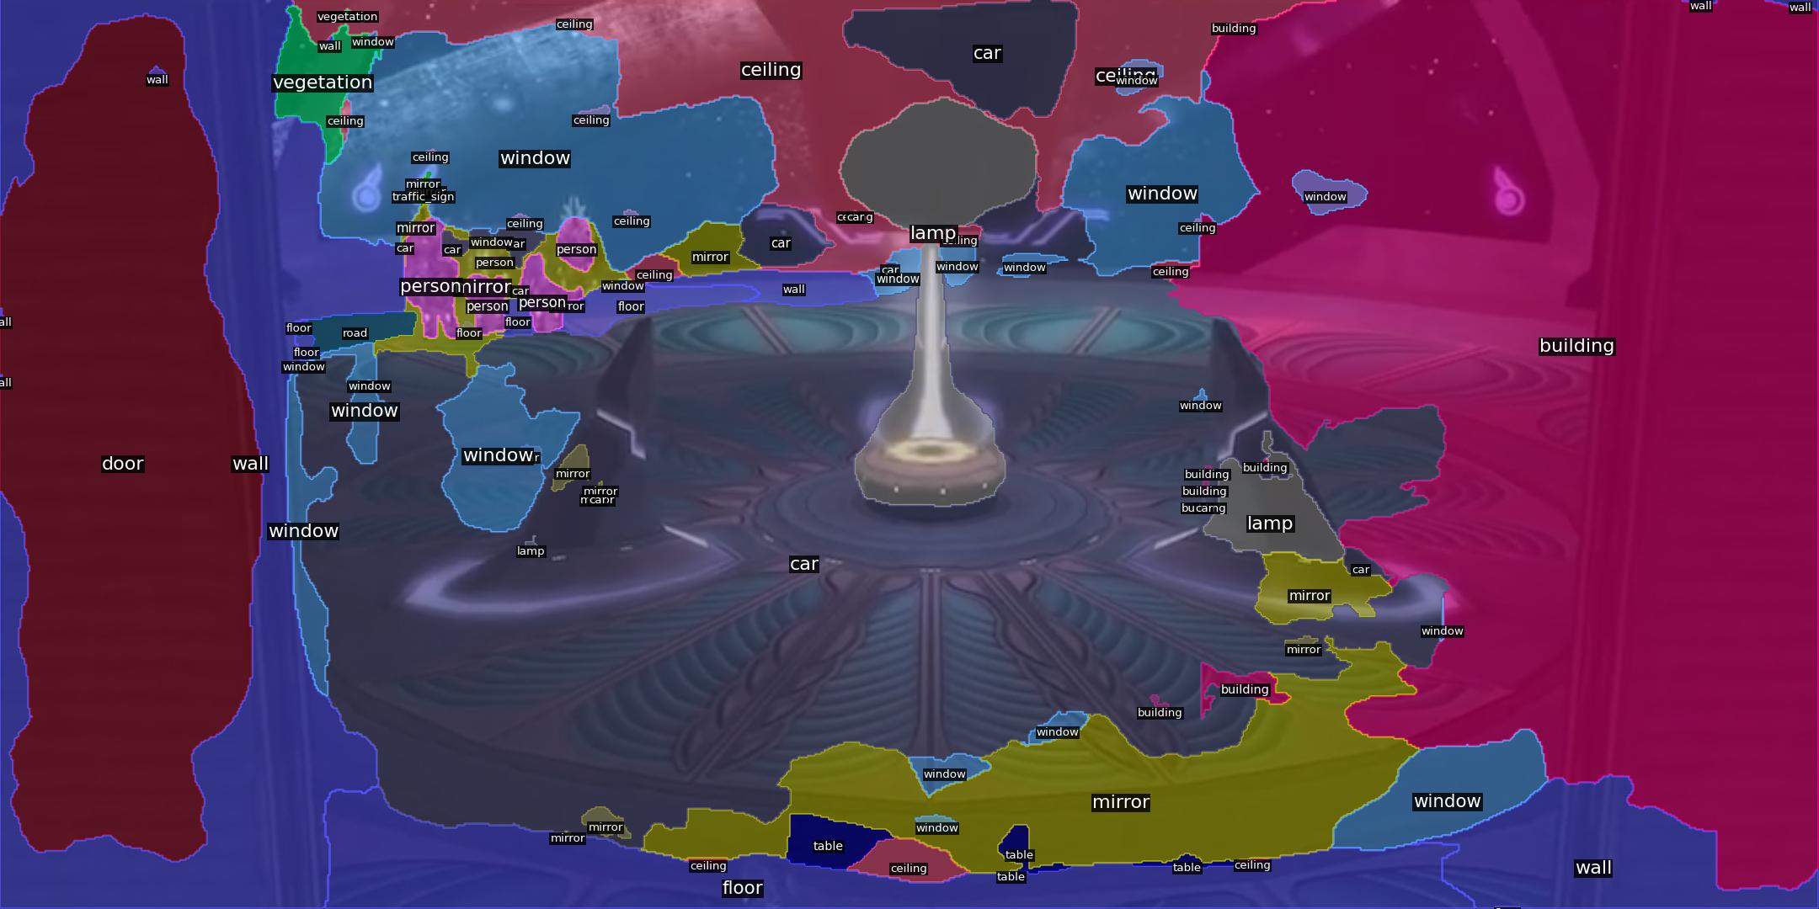

Objective
Automatically remaster old video games with graphics from new installments
Fast unpaired video-to-video translation
Unpaired image-to-image translation models:
Contrastive Unpaired Image-to-Image Translation (CUT)
Adversarial loss and Patch Noise-Contrastive Estimation (NCE) loss
Enhancing Photorealism Enhancements (EPE)
Automatic semantic labeling works poorly on game scenes
G-buffer data are hard to collect
EPE focuses more on making graphics look photorealistic than pure style transfer

Slide 3
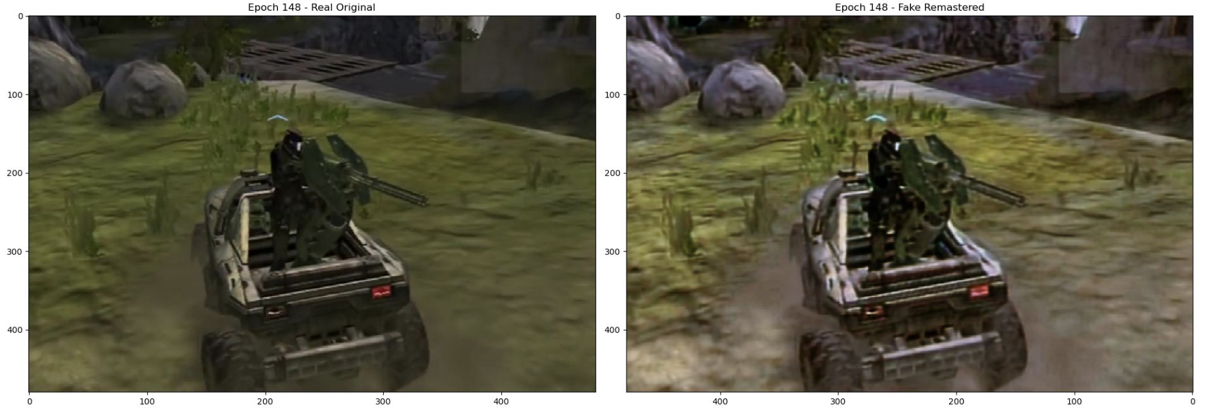
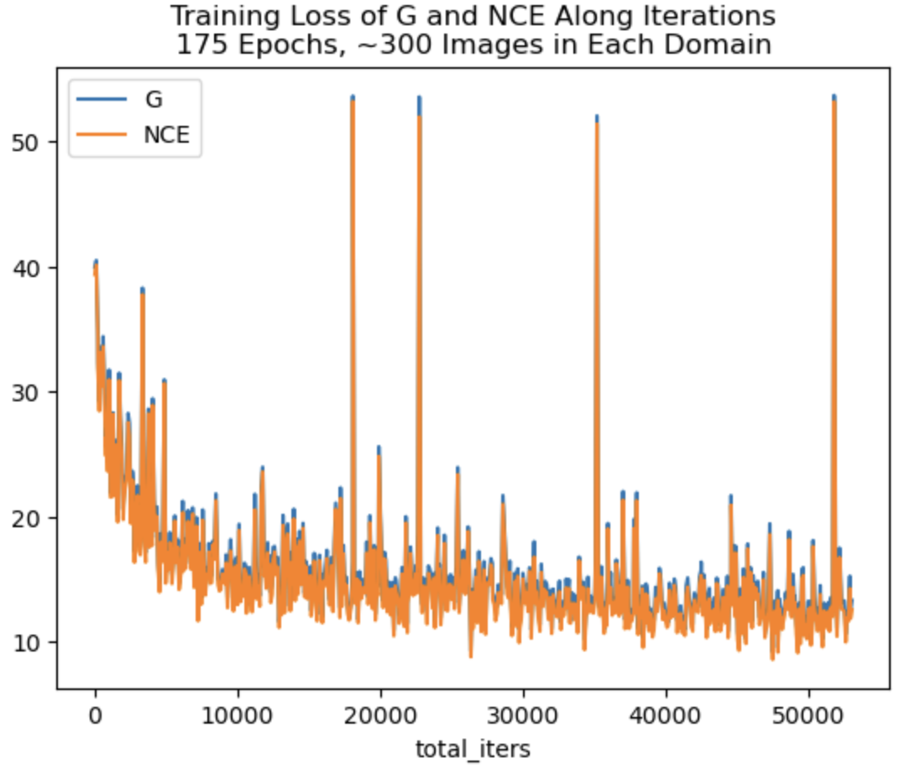
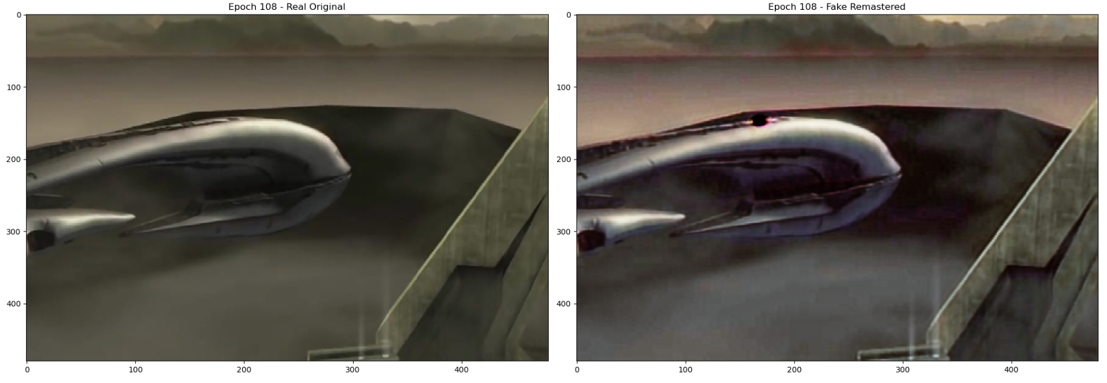
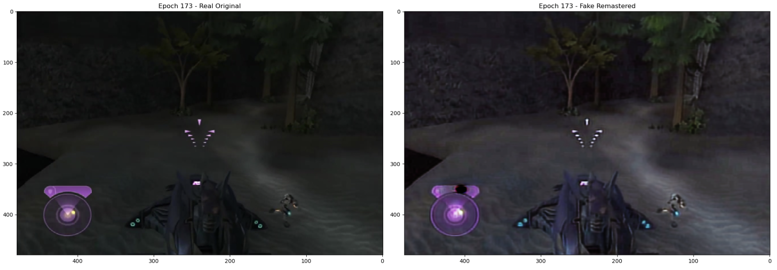

Results

Slide 4
